Slide 1
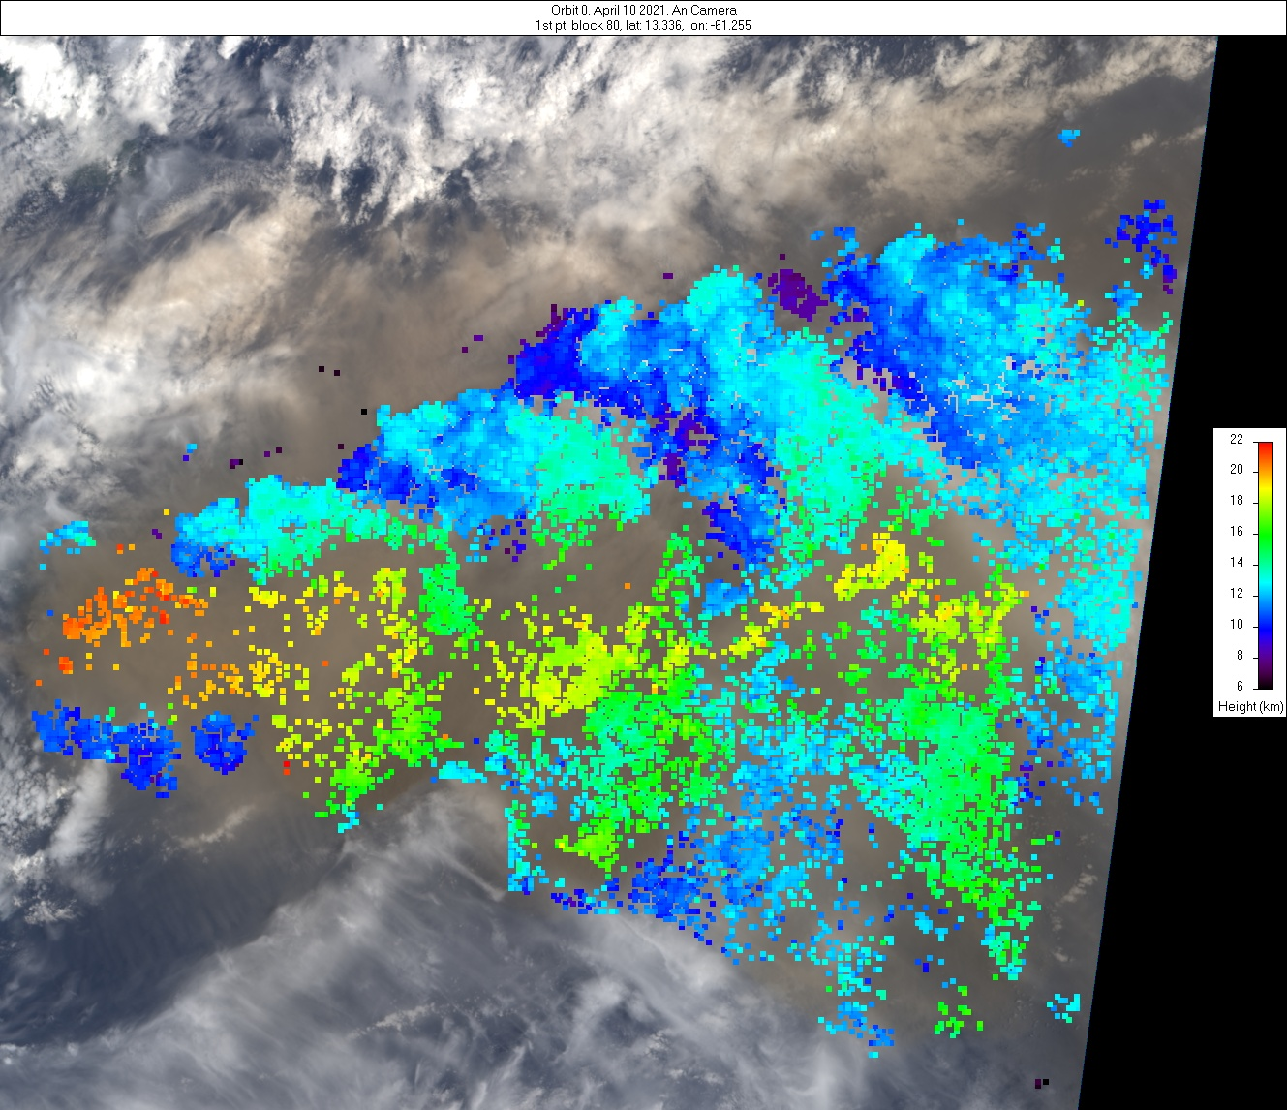
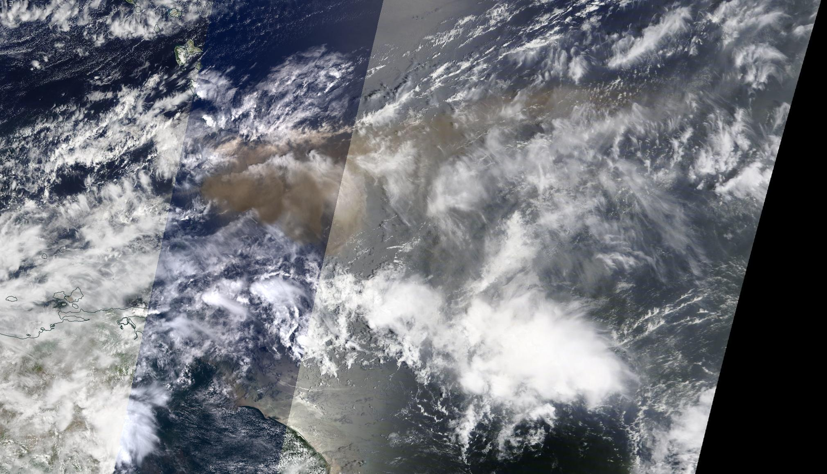
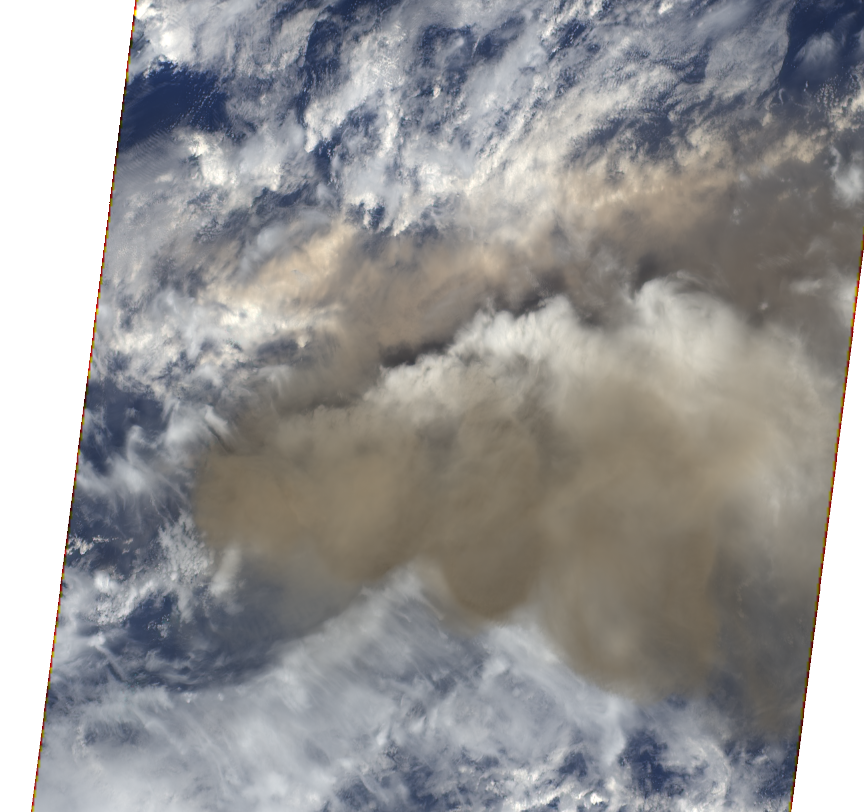
Volcanic eruption plume from La Soufriere Volcano, St. Vincent
MISR Active Aerosol Plume-Height (AAP) Project 10 April 2021
La Soufriere, St Vincent
Plume region
MISR
MODIS Context Image
N
The La Soufriere volcano, on St. Vincent in the Caribbean, began displaying heightened activity in December 2020. An explosive eruption began on 9 April 2021. On 10 April 2021 MISR observed a large plume from the volcano, reaching an altitude of ~18-20 km at its core, with fringes transported at ~12 km. The plume was transported to the east with significant lateral spreading (up to 250 km wide). Visual characteristics indicate ash components, as the plume appears darker than surrounding meteorological cloud. Activity continued for at least several more days, with ongoing eruptions potentially causing regional hazards to populations and aviation.
MISR Plume Heights (ASL)
Red = zero-wind height
Blue = wind-corrected height
Green = surface elevation
N
MISR 60˚ forward view
V. Flower, R. Kahn / NASA GSFC; A. Nastan /JPL

Slide 2
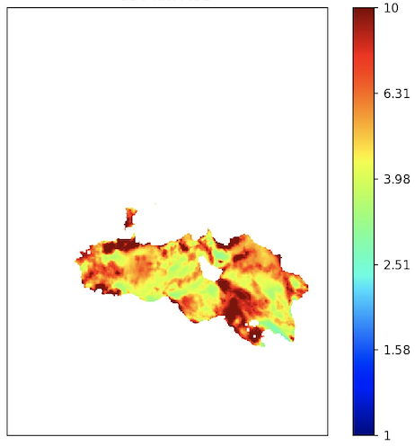
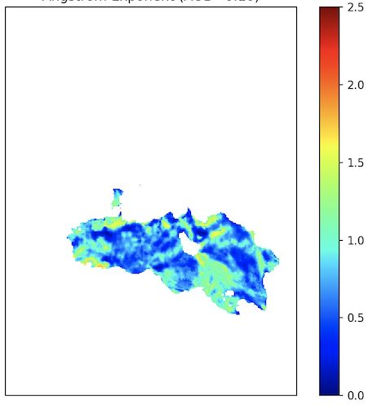
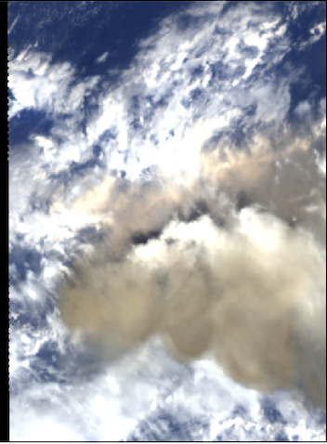
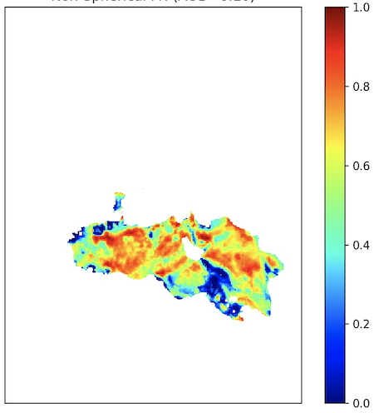
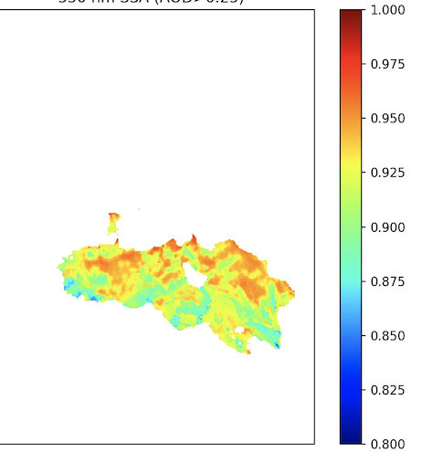
Volcanic eruption plume from La Soufriere Volcano, St. Vincent
MISR Active Aerosol Plume-Height (AAP) Project 10 April 2021
MISR Research Algorithm – Aerosol Amount and Type Retrievals
The plume is visible among significant meteorological cloud. It is optically thick (mid-visible aerosol optical depth >3; Fig. A) and is dominated by large sizes for airborne particles (Angstrom Exponent ~0.5; Fig B).
A
B
MISR 70˚ forward view
AOD (550 nm)
Angstrom Exp.
C
D
The plume shows evidence of non-spherical particles (fraction >0.7; Fig. C) that are light-absorbing (dark) (Single-scattering albedo ~0.92; Fig. D). In summary, the MISR Research Aerosol (RA) retrieval algorithm indicates large, non-spherical, light-absorbing (brown) particles, an ash-rich volcanic plume.
Fr. Non-Sph.
SSA (550 nm)
J. Limbacher, V. Flower, R. Kahn / NASA GSFC

